Slide 1
Object Oriented Programming
Week 7
Email: abeer.gauher@nu.edu.pk
Office: CS BASEMENT 2, Office number 23

Slide 2
Contents
Polymorphism
Overriding
Overloading

Slide 3
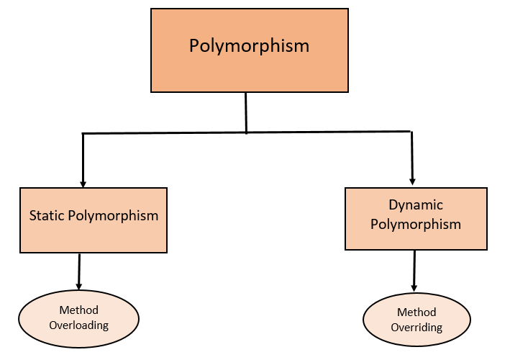
Polymorphism
Refers to the ability to associate multiple meanings to one function name.

Slide 4
Compile Time Polymorphism
The overloaded functions are invoked by matching the type and number of arguments.
This information is available at the compile time and, therefore, compiler selects the appropriate function at the compile time.
It is achieved by function overloading and operator overloading which is also known as static binding or early binding.

Slide 5
Function Overloading
The return type or name of parameters don’t help the compiler in selecting which overloaded function to call.
Function Overloading can be done in two ways:
Either by using different types of arguments or a different number of arguments according to the requirement.
It is only through these differences compiler can differentiate between the two overloaded functions.

Slide 6
Example
void findPerson(string name) { . . . }
void findPerson(int ID) { . . . }
void findPerson(int ID, string addr) { . . . }
void findPerson(string addr, int ID) { . . . }
All of above are valid overloaded functions

Slide 7
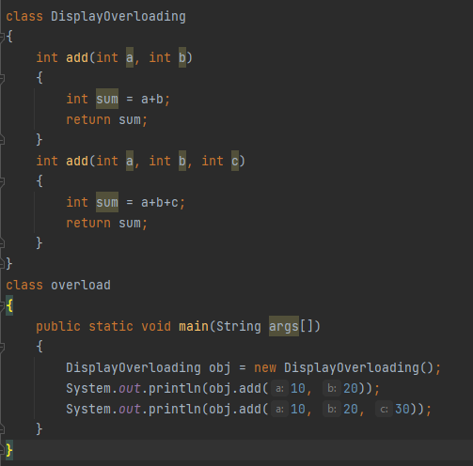

Overloading – Different Number of parameters in signature
Same function in same class.

Slide 8
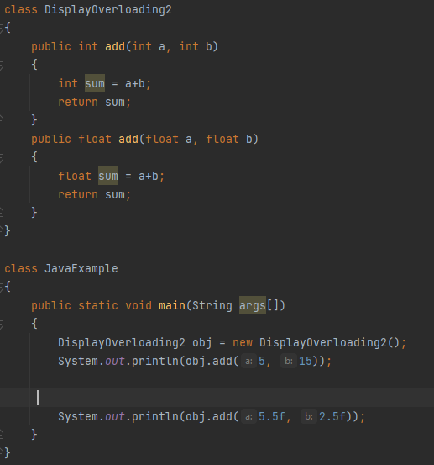

Overloading – Data type of parameters are different

Slide 9
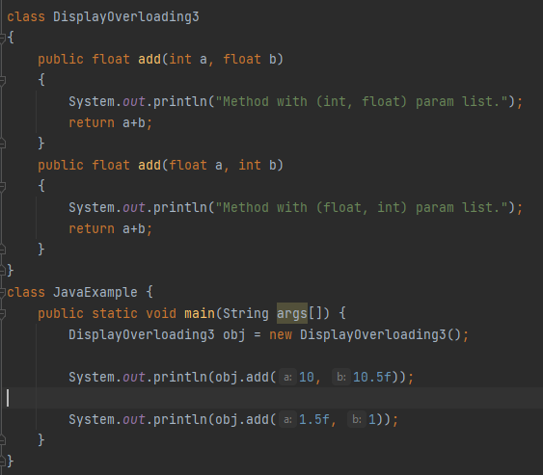
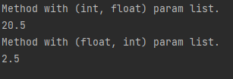
Overloading – Sequence of data type of parameters is different
both the variations of method add() has same number of parameters but the sequence of data type of parameters is different

Slide 10
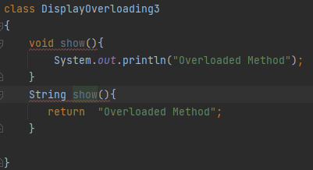
Overloading – Return type
Changing the return type will not achieve overloading.

Slide 11
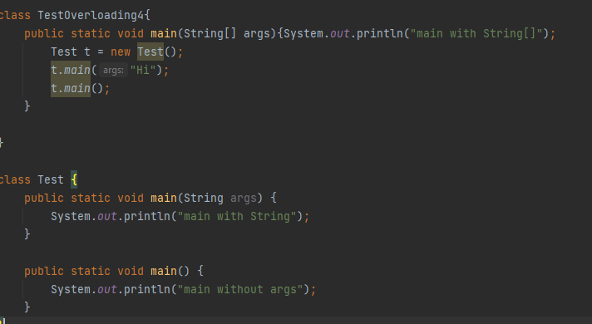

Can we overload java main() method?
Yes, by method overloading. You can have any number of main methods in a class by method overloading. But JVM calls main() method which receives string array as arguments only.

Slide 12
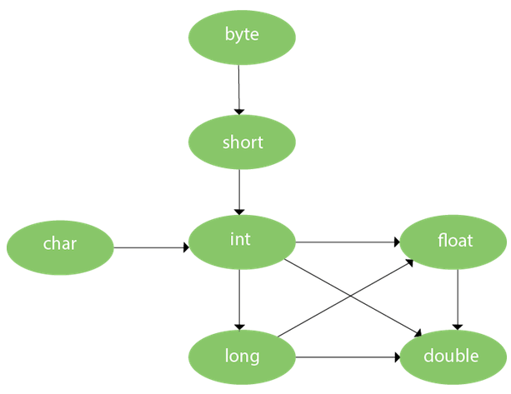
Method Overloading and Type Promotion
One type is promoted to another implicitly if no matching datatype is found.
As displayed in the above diagram, byte can be promoted to short, int, long, float or double. The short datatype can be promoted to int, long, float or double. The char datatype can be promoted to int,long,float or double and so on.

Slide 13
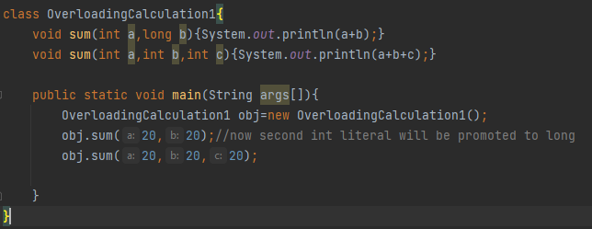

Method Overloading and Type Promotion

Slide 14
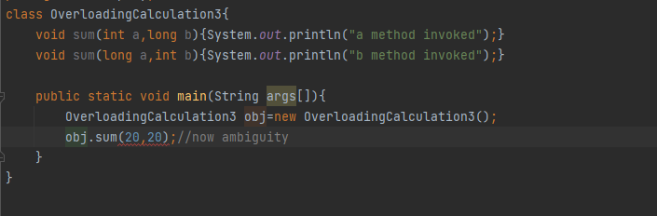
Example of Method Overloading with Type Promotion in case of ambiguity
If there are no matching type arguments in the method, and each method promotes similar number of arguments, there will be ambiguity.

Slide 15
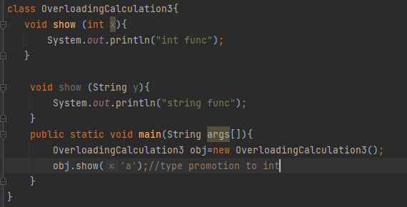

Example of Method Overloading with Type Promotion in case of ambiguity
Type promotion of char to int.

Slide 16
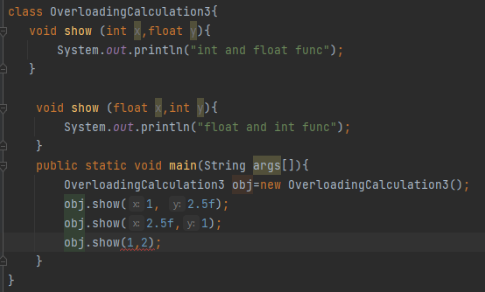
Example of Method Overloading with Type Promotion in case of ambiguity
The first 2 statements in the main method execute without any error.
Obj.show(1,2): Since both are int arguments and int can be promoted to float, ambiguous call.

Slide 17
Polymorphism
Inheritance allows you to define a base class and derive classes from the base class
Polymorphism allows you to make changes in the method definition for the derived classes and have those changes apply to methods written in the base class

Slide 18
Runtime Polymorphism
Run-time polymorphism takes place when functions are invoked during run time.
It is also known as dynamic binding or late binding.
Function overriding is used to achieve run-time polymorphism.
In contrast, to compile time polymorphism, the compiler decides the object at run time and then decides which function call to bind to the object.
Function overriding cannot be done within a class. The function is overridden in the derived class only. Hence inheritance should be present for function overriding.
The function from a base class that we are overriding should have the same signature or prototype i.e. it should have the same name, same return type and same argument list.

Slide 19
Overriding Versus Overloading
Do not confuse overriding with overloading
Overriding takes place in subclass – new method with same signature
Overloading
New method in same class with different signature

Slide 20
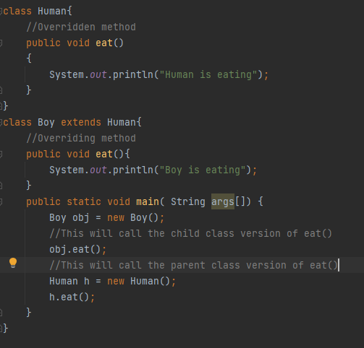

Example

Slide 21
An Inheritance as a Type
The method can substitute one object for another
Called polymorphism
This is made possible by mechanism
Dynamic binding
Also known as late binding

Slide 22
Dynamic Binding and Inheritance
When an overridden method invoked
Action matches method defined in class used to create object using new
Not determined by type of variable naming the object
Variable of any ancestor class can reference object of descendant class
Object always remembers which method actions to use for each method name

Slide 23
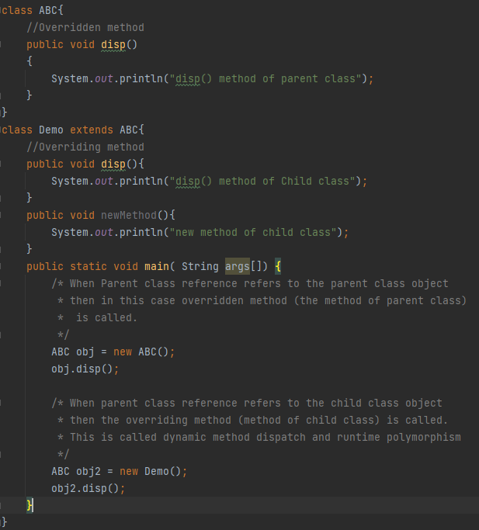

Method Overriding and Dynamic Method Dispatch
Method Overriding is an example of runtime polymorphism. When a parent class reference points to the child class object then the call to the overridden method is determined at runtime, because during method call which method(parent class or child class) is to be executed is determined by the type of object. This process in which call to the overridden method is resolved at runtime is known as dynamic method dispatch.
In dynamic method dispatch the object can call the overriding methods of child class and all the non-overridden methods of base class but it cannot call the methods which are newly declared in the child class. In the above example the object obj2 is calling the disp().

Slide 24
Rules of method overriding
Argument list: The argument list of overriding method (method of child class) must match the Overridden method(the method of parent class). The data types of the arguments and their sequence should exactly match.
Access Modifier of the overriding method (method of subclass) cannot be more restrictive than the overridden method of parent class. For e.g. if the Access Modifier of parent class method is public then the overriding method (child class method ) cannot have private, protected and default Access modifier,because all of these three access modifiers are more restrictive than public.

Slide 25
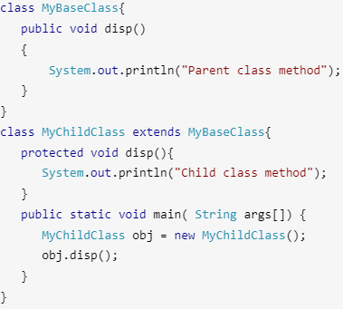
Rules of method overriding
Access Modifier of the overriding method (method of subclass) cannot be more restrictive than the overridden method of parent class. For e.g. if the Access Modifier of parent class method is public then the overriding method (child class method ) cannot have private, protected and default Access modifier,because all of these three access modifiers are more restrictive than public.

Slide 26
Rules of method overriding
private, static and final methods cannot be overridden as they are local to the class. However static methods can be re-declared in the sub class, in this case the sub-class method would act differently and will have nothing to do with the same static method of parent class.
Binding of overridden methods happen at runtime which is known as dynamic binding.

Slide 27
The final Modifier
Possible to specify that a method cannot be overridden in subclass.
Add modifier final to the heading public final void specialMethod()
An entire class may be declared final
Thus cannot be used as a base class to derive any other class.

Slide 28
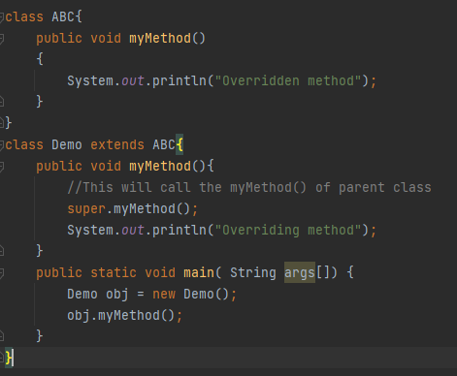

Calling an Overridden Method
Reserved word super can also be used to call method in overridden method

Slide 29
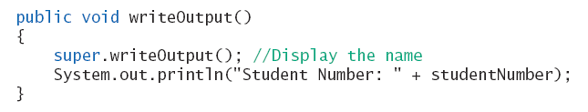
Calling an Overridden Method
Reserved word super can also be used to call method in overridden method
Calls method by same name in base class

Slide 30
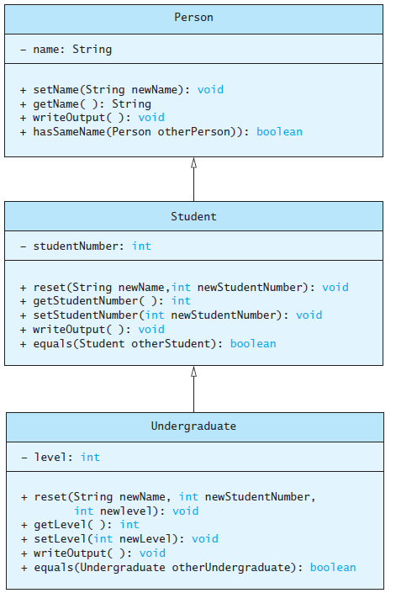
Polymorphism
Consider an array of Person
Person[] people = new Person[4];
Since Student and Undergraduate are types of Person, we can assign them to Person variables
people[0] = new Student("DeBanque, Robin", 8812);
people[1] = new Undergraduate("Cotty, Manny", 8812, 1);

Slide 31
Polymorphism
Given:
Person[] people = new Person[4];
people[0] = new Student("DeBanque, Robin", 8812);
When invoking:
people[0].writeOutput();
Which writeOutput() is invoked, the one defined for Student or the one defined for Person?
Answer: The one defined for Student

Slide 32
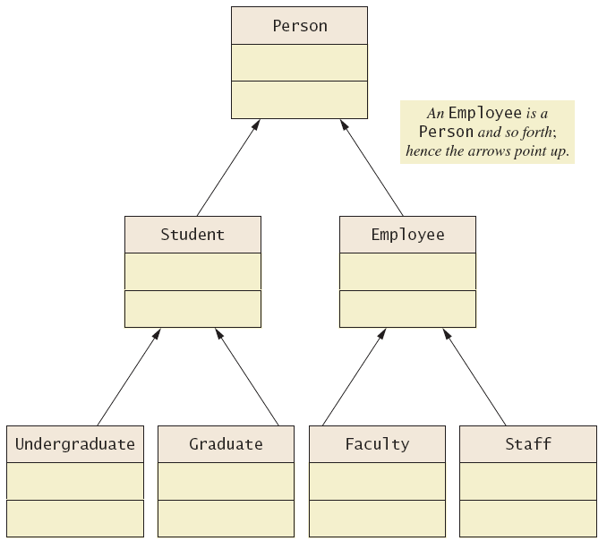
UML Inheritance Diagrams

Slide 33
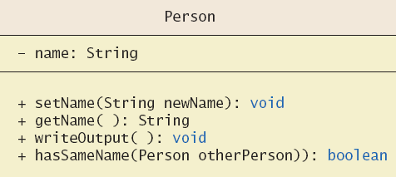
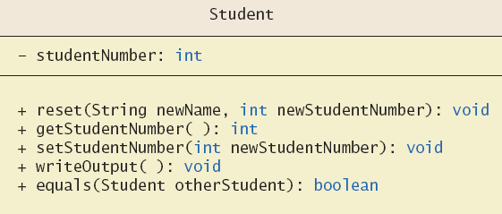
UML Inheritance Diagrams

